Slide 1
From Notes to Harmony: An Insight into Musical Theory
Created by
Maria Andrei
Guided by
Assoc. Prof. Raulea Cristina, from Lucian Blaga University of Sibiu

Slide 2
01
Introduction
My hope and motivation for this project

Slide 3
Introduction
The motivation for this project stems from the recognition of a significant educational deficit. Many musicians, despite years of practice, overlook the importance of music theory, which is critical for a deeper understanding and appreciation of music.
As Beethoven once said, "To play a wrong note is insignificant; to play without passion is inexcusable." By fostering a robust theoretical foundation, this project aims to ignite that passion and enhance musicians' overall proficiency.

Slide 4
02
Theory and fundamentals
Why should you give them your attention?

Slide 5
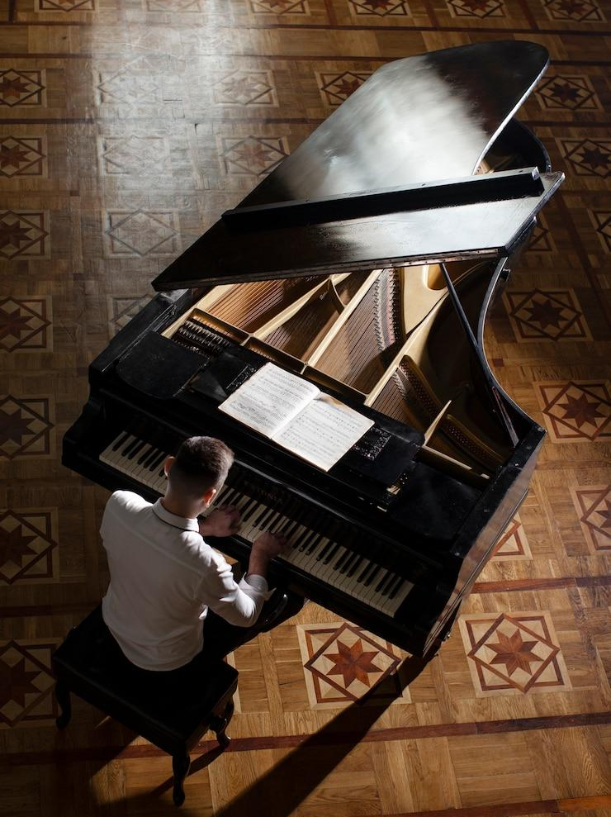
We think of music as just sounds that please the ear, but music’s just so much more than that. It shows discipline, dedication and passion. Those things don’t come by night. It is something that we develop over time.
There’s a great quote from Pyotr Tchaikovsky that says: “Inspiration is a guest that does not willingly visit the lazy”.
Understanding the way music is written and created plays an important role in resonating with your own created sounds on any instrument.

Slide 6
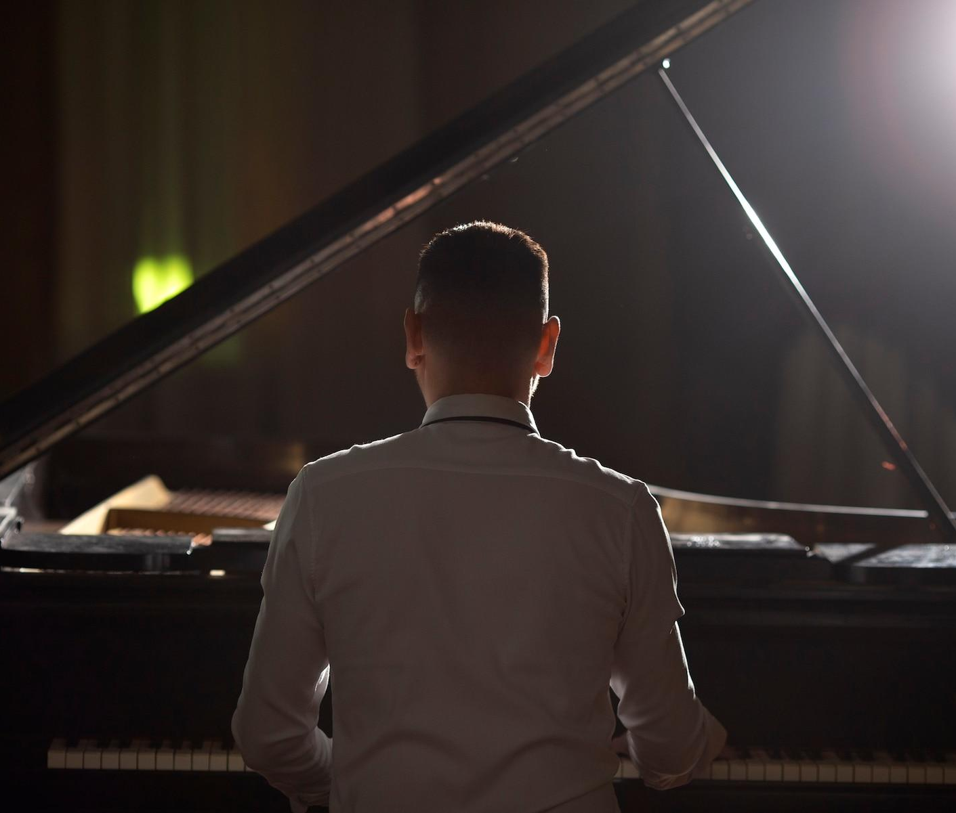
So how can knowing all those musical notions actually help you?
Over 90% of musical compositions, whether classical or modern, are fundamentally based on these principles. Understanding them makes it easier to interpret or read any given piece.

Slide 7
03
Tools and technologies
The building blocks of the project

Slide 8





The building blocks of this project:
HTML
CSS
JAVASCRIPT
PYTHON

Slide 9
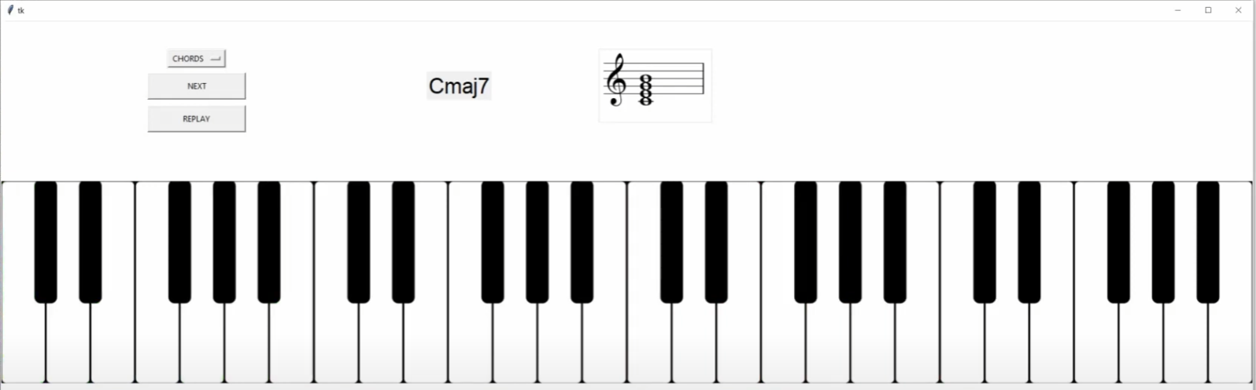
The project consists of a site meant to teach you the theory and an interface that helps you practice the concepts that you learnt.
The way this interface works is by picking the messages that are sent between the Computer and the Keyboard through a MIDI connection ( Musical Instrument Digital Interface) and interpreting them using images that overlap on the interface. If the notes played correspond with the ones of the exercise, then they will be colored with a green color. If they don’t, they will be colored with a red color.

Slide 10
—Gustav Mahler
“I am hitting my head against the walls, but the walls are giving way.”

Slide 11
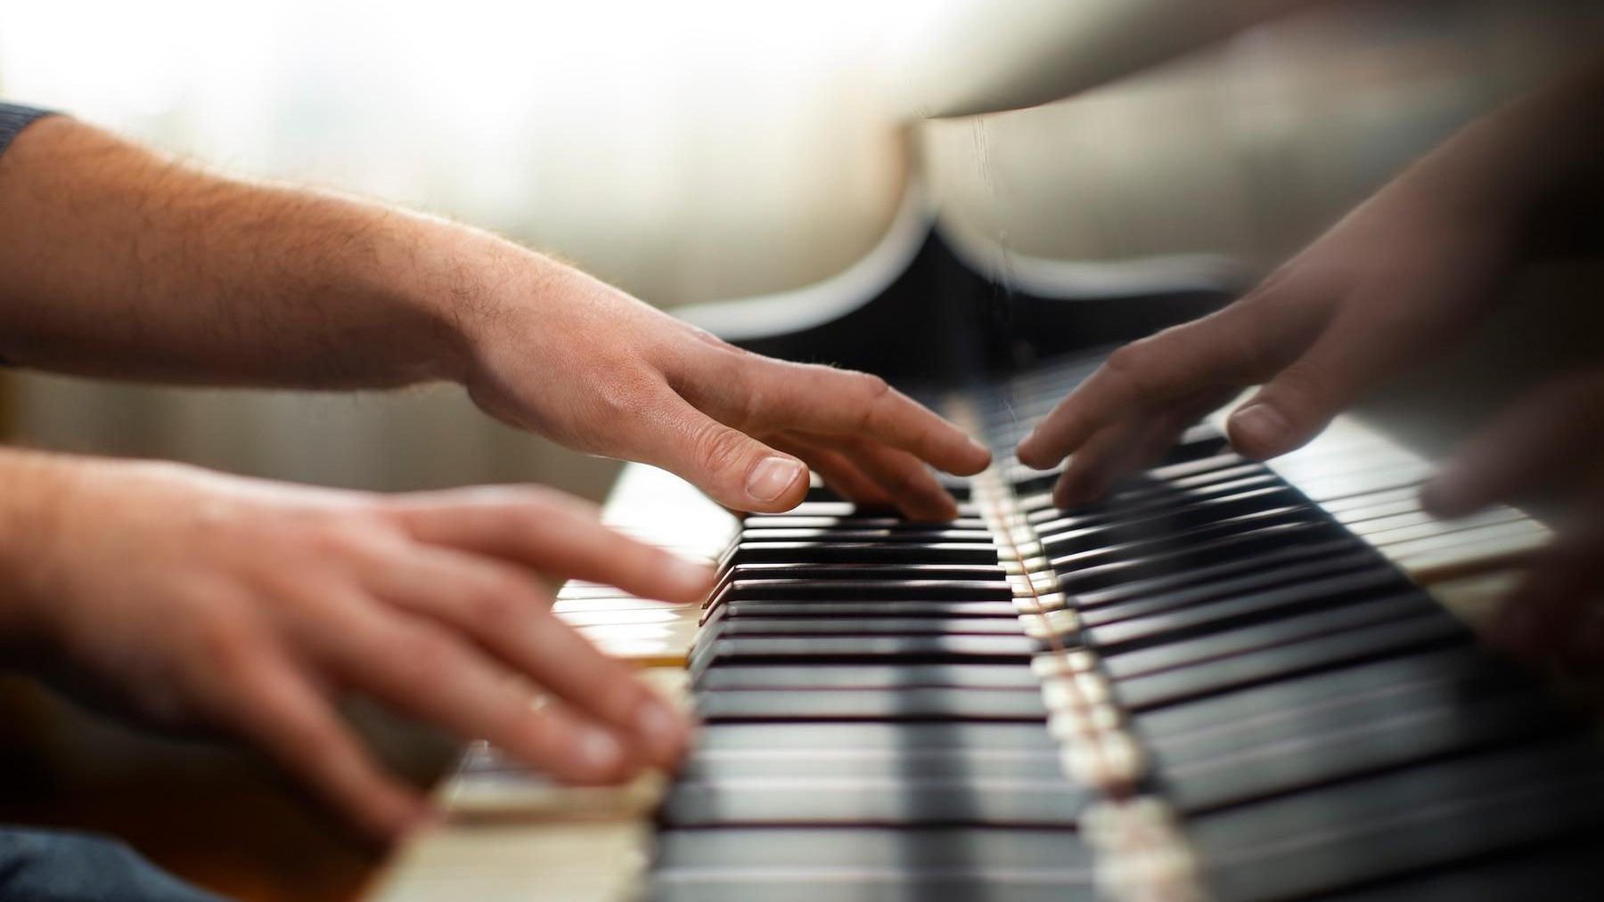
Thank you for your time !!!

